Slide 1

Team: Mind Bender
Members:
Moosa Siddiqui – 61855
Nausherwan Khan Adil – 61819
Abdul Qayyum – 60809
Muhammad Anas Khan – 61853

Slide 2
Book:
Entrepreneurs Grow at Warp Speed
Author:
Steve Pavlina

Slide 3

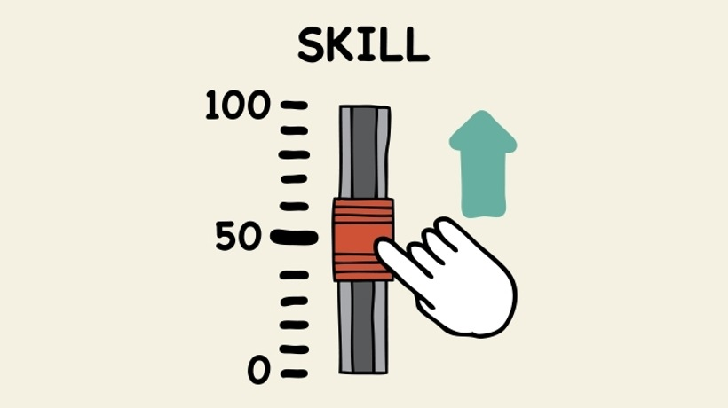

GROW SMARTER:
Solving problem will make your min active and strong.
Centre your self and take time off.
Being into business will develop your skills.
Develop skill to take immediate action in any situations.

Slide 4

STOP WORKING WITH IDIOTS:
Choose smart people and who have same mindset as you.
Best thing about business is that you can choose that with whom you want to work with.
You cant tell about any one in first meeting.
It take time to realize that who is creative and who is idiot.

Slide 5




MAKE BETTER DECISIONS:
Make smart decisions.
Focus on best opportunity.
Learn to prioritize.

Slide 6
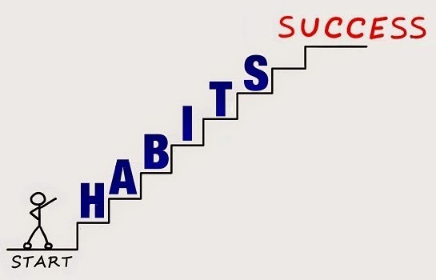
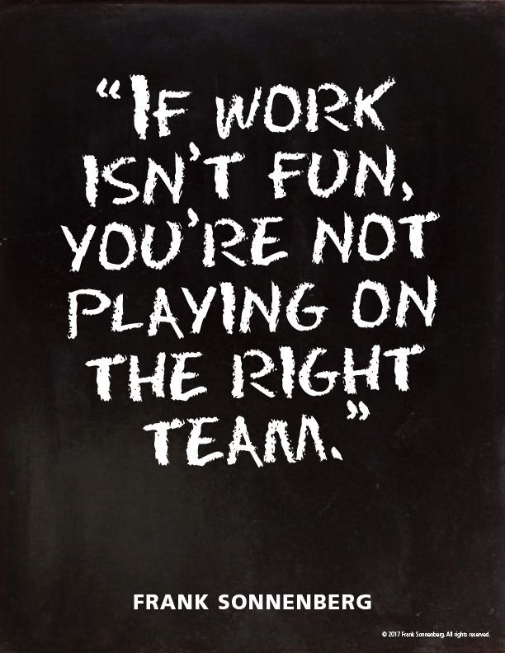

UPGRADE YOUR HABITS:
Adapt good habits.
Don’t miss golden chances just because of your bad habits.
Came up with unique habits.
Work hard with fun.

Slide 7


LEARN PATIENCE AND CONSIDER ABONDONING DEADLINE:
IMPATIENCE WILL RUIN YOUR PLAN AND ESTIMATION
DRAINING OF MOTIVATION.
PREFER WORKING WITHOUT DEADLINE.
FOCUS ON QAULITY OF WORK.

Slide 8


TACKEL THE MONSTER PROJECT:
DON’T HESITATE TO DO MONSTER PROJECT.
SELF GROWING TIME.
LEARNING PATIENCE.
SKILL BUILDING AND GAINING EXPERIENCE.
“YOU WILL GROW THROUGH WHAT YOU WILL GO THROUGH”

Slide 9

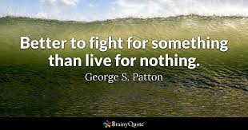
LEARN THE PAIN OF PERFECTIONISM:
BE IMPERFECT.
DON’T STOP JUST KEEP MOVING.
SOMETHING IS BETTER THAN NOTHING.
IMPERFECTION WILL MAKE YOU PERFECT.

Slide 10



Stop being a technology dunce
YOU WILL NOT SURVIVE IN MODERN WORLD
BUSSINESS WILL PUNISH YOU FOR BEING DUNCE
COMPUTERS AND SOFTWARE HANDLE MOST OF THE MARKETING,
DISTRIBUTION, AND INCOME GENERATION ASPECTS OF THE
BUSSINESS

Slide 11



OVERCOME LIMITED THINKING
“You begin to fly when you let go of self-limiting beliefs and allow your mind and aspirations to rise to greater heights.” ―Brian Tracy
“I’m not interested in your limiting beliefs; I’m interested in what makes you limitless.” ―Brendon Burchard

Slide 12


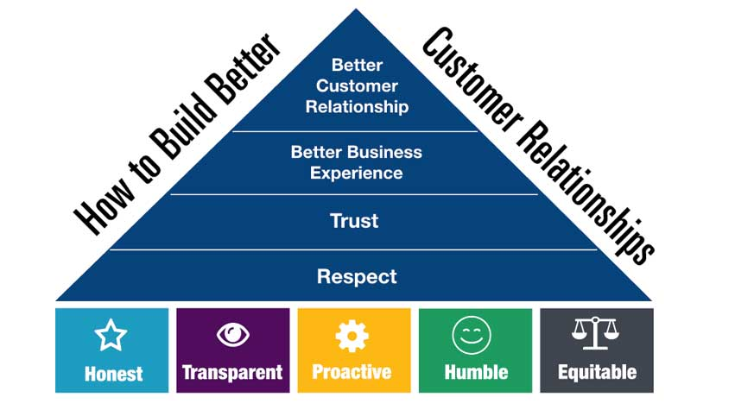
Learn to spend wisely
MANAGE TIME AND MONEY EFFECTIVELY
BUILD A BETTER CUSTOMER RELATION.
TRUST
MAKE PLAN AND WRITE IT DOWN

Slide 13
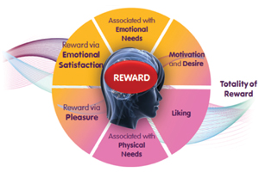
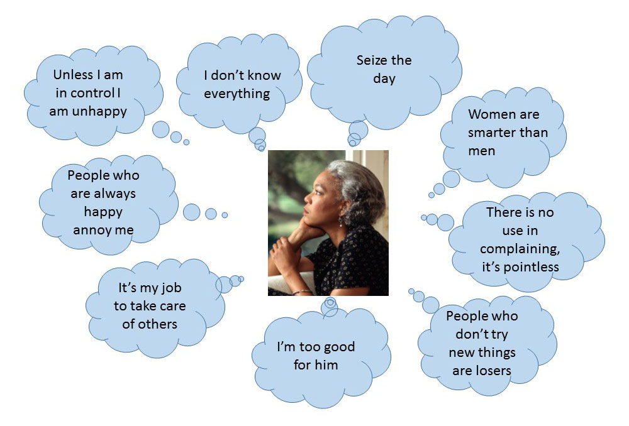
UNDERSTAND HUMAN BEHAVIOUR
consideration the person's beliefs, values, lifestyle, way of thinking and all other variables that affect him directly or indirectly.
You’ll discover better ways to generate sales, reduce expenses, prevent fraud, increase your productivity, and more.

Slide 14



TAKE COMMAND OF YOUR LIFE
Consistently be your BEST self and stop trying to impress people.
Stop looking for approval and instead approve of yourself.
Be genuine in your likes, dislikes, feelings, compliments, etc.

Slide 15

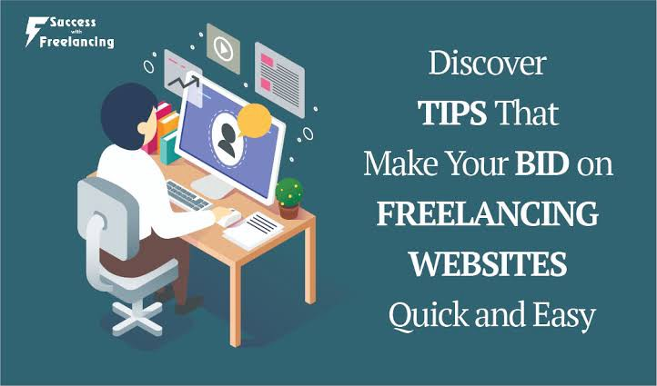
GET PAID TO GROW
Business pays you as more as you can earn and learn.
The smarter you become the more you can apply, what you learn to your business, so your own learning and growth can conclude you with the higher income.
The wonderful thing is when your business benefits from your personal growth your business can justify covering your personal expenses.

Slide 16
ARE THESE APPLICABLE IN PAKISTAN:
Yes these are applicable in Pakistan these are. Its not only applicable in Pakistan its for anyone who is going to start a business. These are the basic rules that one should know when starting a business. This will surely be very helpful in the start up and will get you through the difficult situation easily. These are the some key points for success.

